Slide 1
Travelling Salesman optimization problem Using Simulated Annealing
TEAM MEMBERS:​
S.J SUMANTH (2010030377)​
K. SREEVARUN (2010030451)​
E. PAVAN SAI (2010030538)​
E. SHIVA GOUD (2010030542)

Slide 2
Outline
Introduction
Problem Statement
GitHub commits
Work progress
Alpha testing
Flow chart

Slide 3
Introduction
With the development of Big Data technology, graphics computing is applied to all kinds of fields. For example, an entire social network is a graph in which the user is the vertex of the graph, and the relationship between the user and another user is regarded as the edge. As can be seen from the above example, as a storage or presentation form in a specific application, how to mine the knowledge contained in a graph by quickly traversing the vertices in the graph is a research hotspot in the field of graphics computing.
Traversing all the vertices in the graph and repeating is an important application direction in graph-vertex traversal. Traversing all the vertices in the graph is a classical traveling-salesman problem (TSP) in the shortest time. It is well known that TSP is an NP-hard problem .To solve the problem, besides traditional backtracking algorithms, branch-and-bound algorithms, and greedy algorithms, we mainly use heuristic search algorithms to optimize. These heuristic algorithms include the simulated annealing algorithm, tabu-search algorithm, ant-colony optimization algorithm ,and genetic algorithm.

Slide 4

Problem Statement
The traveling salesman problem (TSP) using simulated annealing is a algorithmic problem tasked with finding the shortest route between a set of points and locations that must be visited.
The salesperson should travel from one point and visit all the required cities/point and return to the start point with shortest path and visiting of same point should note be repeated.

Slide 5
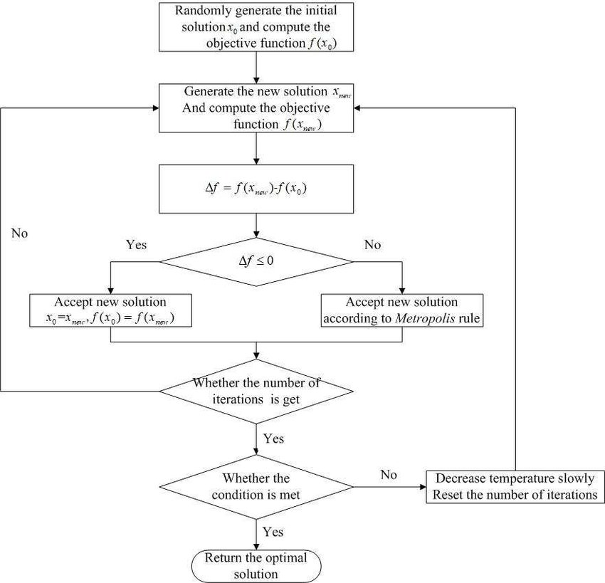
FLOW CHART

Slide 6
Implementation Steps
Step 1:
Start with a random tour through the selected cities. Note that it’s probably a very inefficient tour!
Step 2:
Pick a new candidate tour at random from all neighbors of the existing tour. This candidate tour might be better or worse compared to the existing tour, i.e. shorter or longer.
Step 3:
If the candidate tour is better than the existing tour, accept it as the new tour.

Slide 7
Implementation Steps
Step 4:
If the candidate tour is worse than the existing tour, still maybe accept it, according to some probability. The probability of accepting an inferior tour is a function of how much longer the candidate is compared to the current tour, and the temperature of the annealing process. A higher temperature makes you more likely to accept an inferior tour.
Step 5:
Go back to step 2 and repeat many times, lowering the temperature a bit at each iteration, until you get to a low temperature and arrive at your (hopefully global, possibly local) minimum. If you’re not sufficiently satisfied with the result, try the process again, perhaps with a different temperature cooling schedule.

Slide 8
GitHub Commits
XYZ

Slide 9
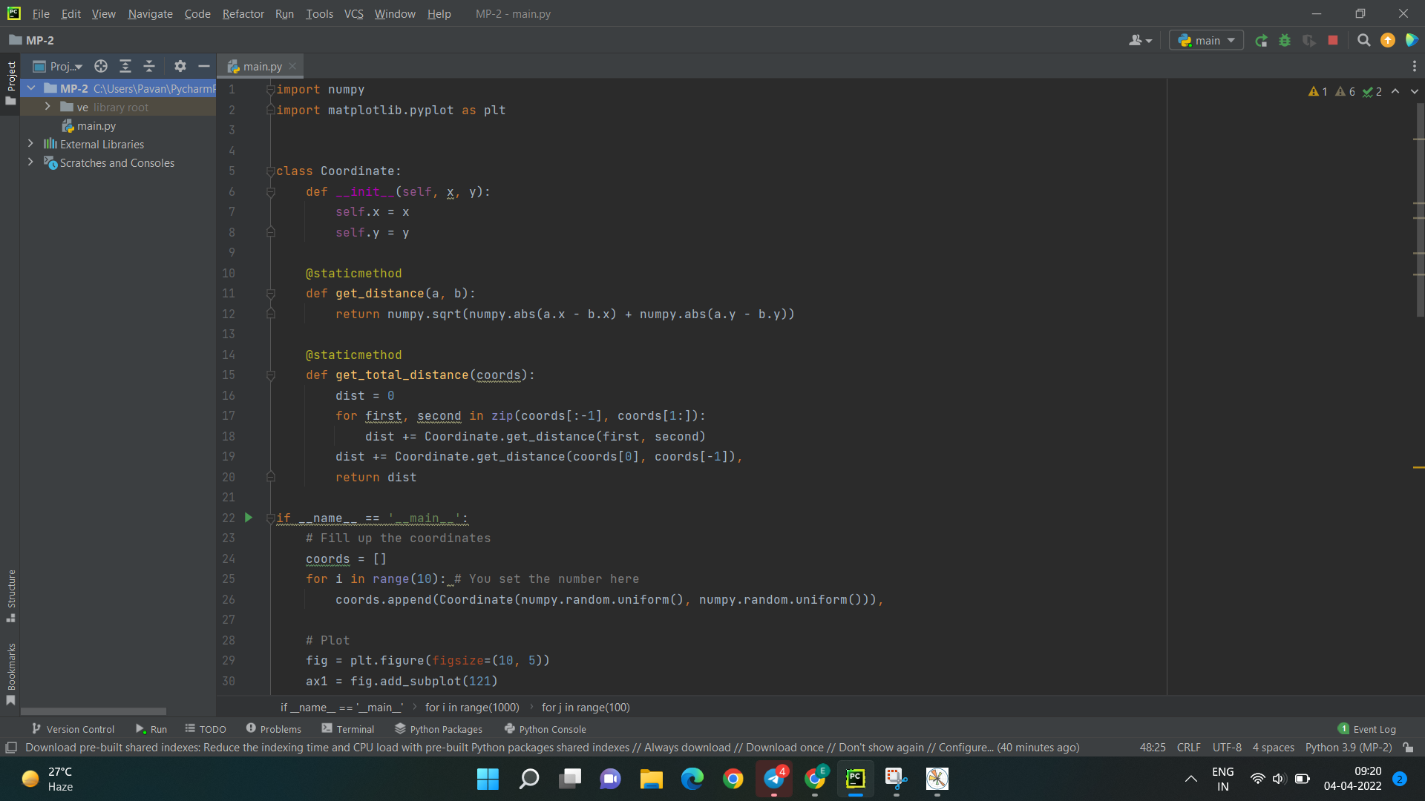
ALPHA TESTING

Slide 10
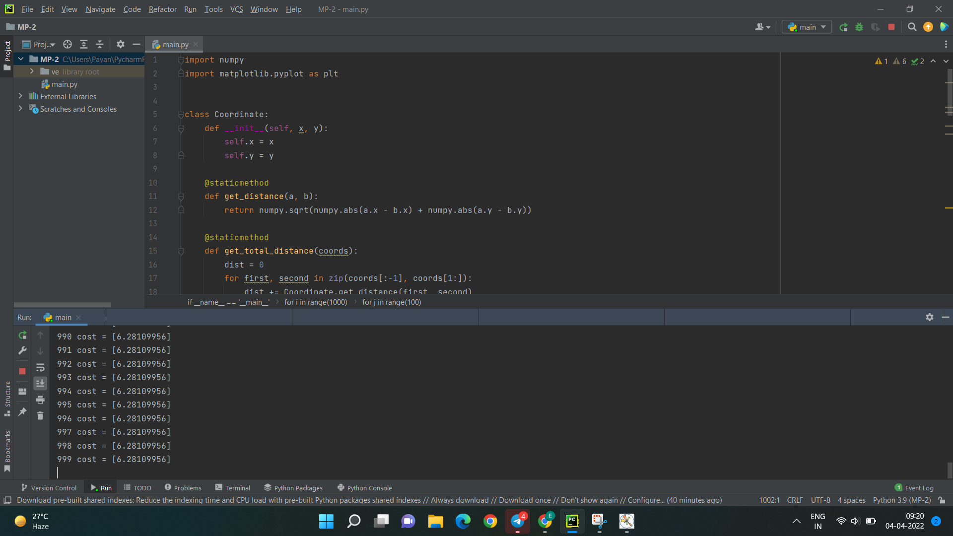
ALPHA TESTING

Slide 11
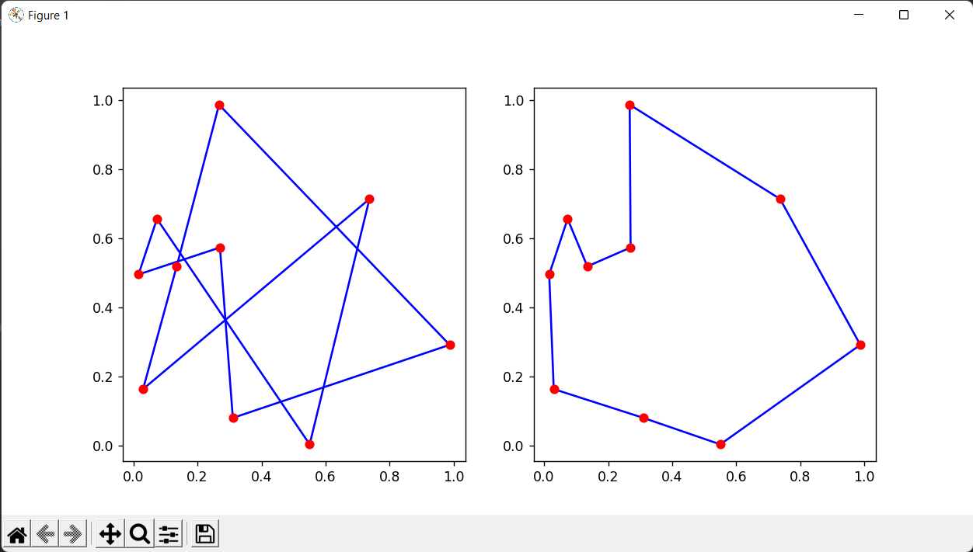
ALPHA TESTING

Slide 12


